Slide 2
The MFP Market
The MFP segment is today covered mainly by MFPs from the major brands.
These solutions are used in 2 ways:
Mark-up and scan changes and notes.
Create copies as needed.
Solutions from 3rd parties are typically complex and require an external PC or panel PC to operate.

Slide 3
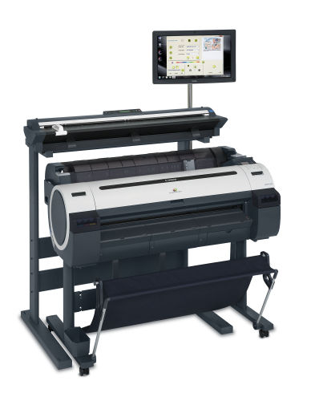
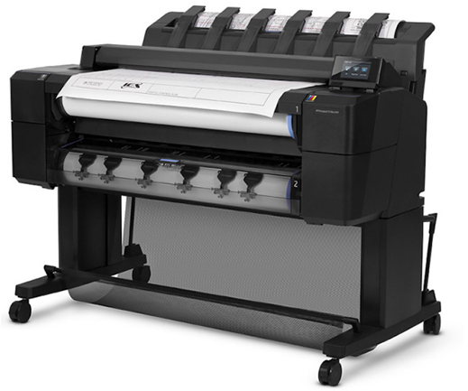
Today’s MFP Solutions
Embedded solutions are limited in functionally and printer support.
Non-embedded solutions are complex to setup and use.
No MFP from a major brand supports other brands printers

Slide 4
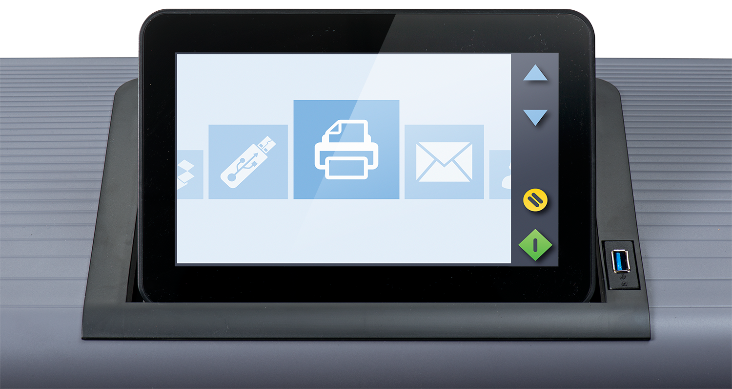

Slide 14
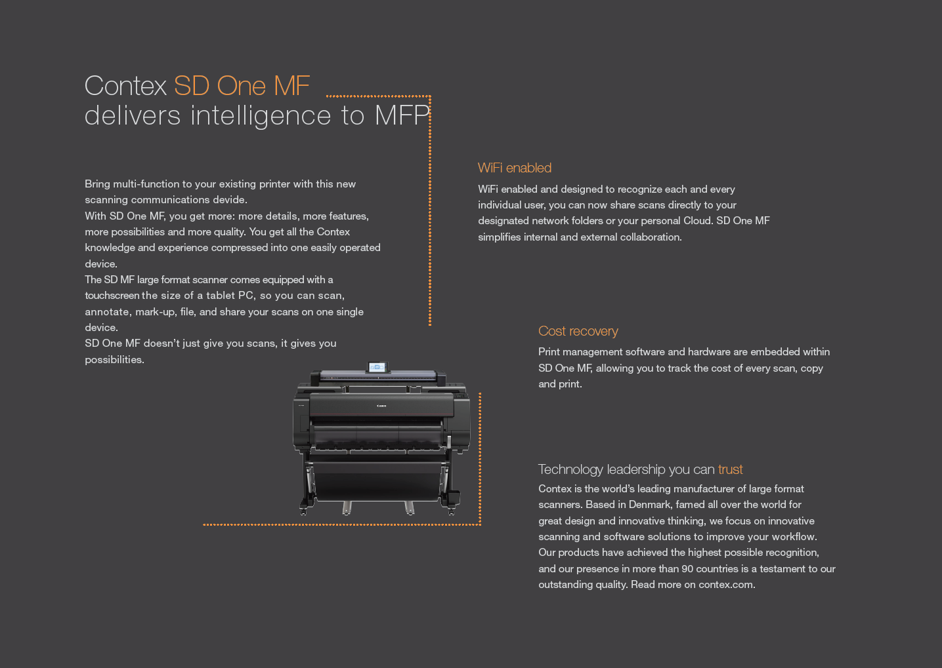

Slide 16
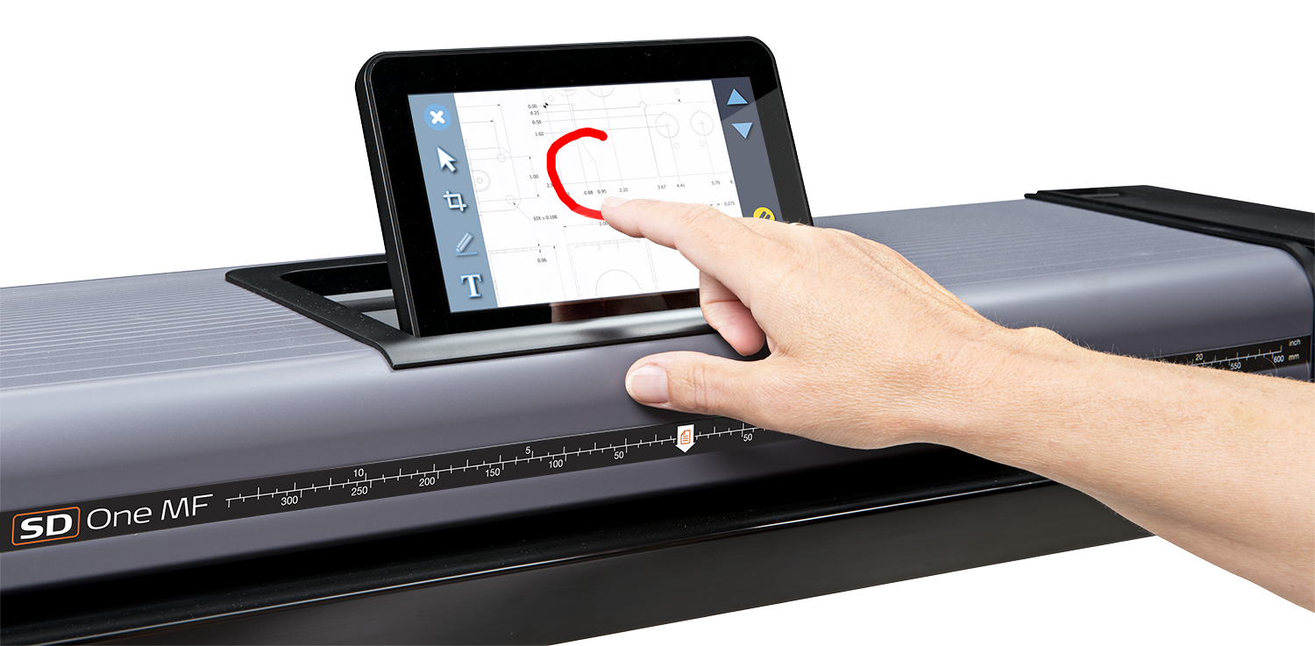
Mark-up and annotate
No need to use costly ink and paper.
Mark-up and annotate directly on the screen and share digital copies.

Slide 17
Mark-up and annotate without printing
Scan
Annotate
Share

Slide 18
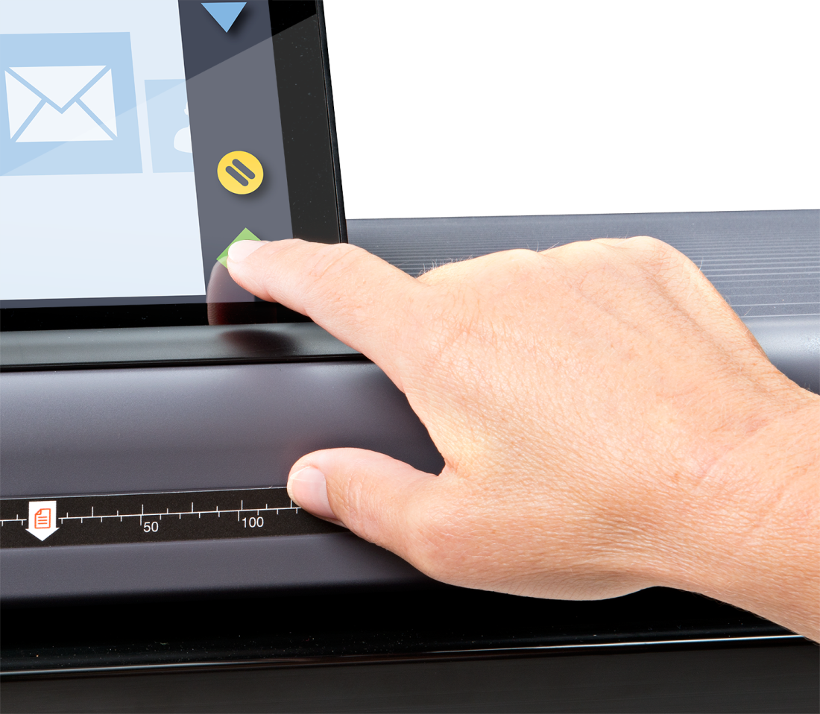
A new Multifunction Scanner
Intuitive touch screen interface
Support all major brand printers
Mark-up and annotate directly on the screen
Share across company network with LINK app.
Share using integrated Cloud support

Slide 19
New ways to operate
Create copies with HP, Canon or EPSON
Scan to USB 3.0 directly on the scanner.
Scan to local PCs using an intuitive client app.
Share with any major Cloud sharing tool.
Scan to Email using integrated email tool.

Slide 20
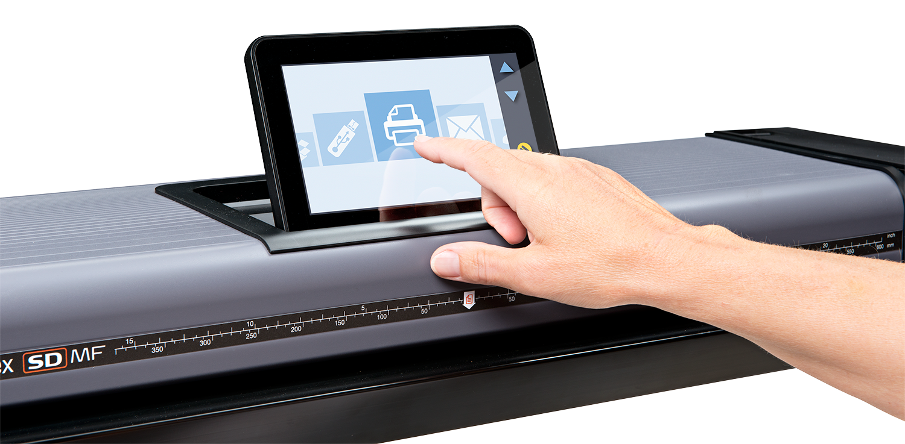
New intuitive user inferface
The High Resolution Multi-Touch Screen supports swipe and pinch to make every operation as intuitive as you smart phone.

Slide 21
Contex LINK
Connect all your users with the scanner instantly with Contex LINK.
Install the client app directly from the SD One MF and it automatically creates a profile for the user on the scanner.
The users can then swipe on the screen to select their profile and scan to their local PC or preferred Cloud platform.

Slide 22
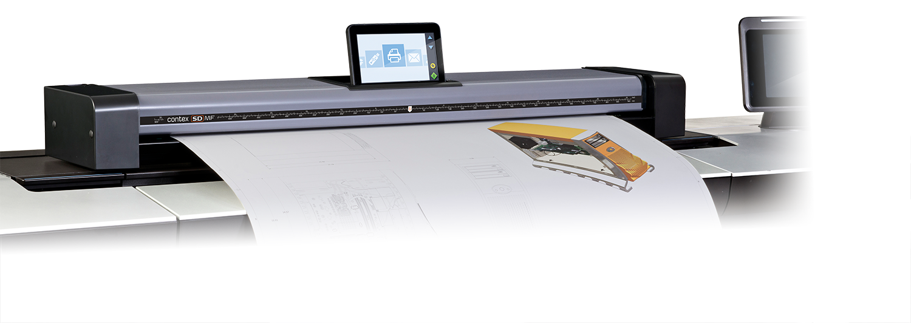
3 ways to combine with your printer
High stand above your large format printer
Low stand as side-by-side next to your printer
Placed on any flat, solid surface

Slide 23
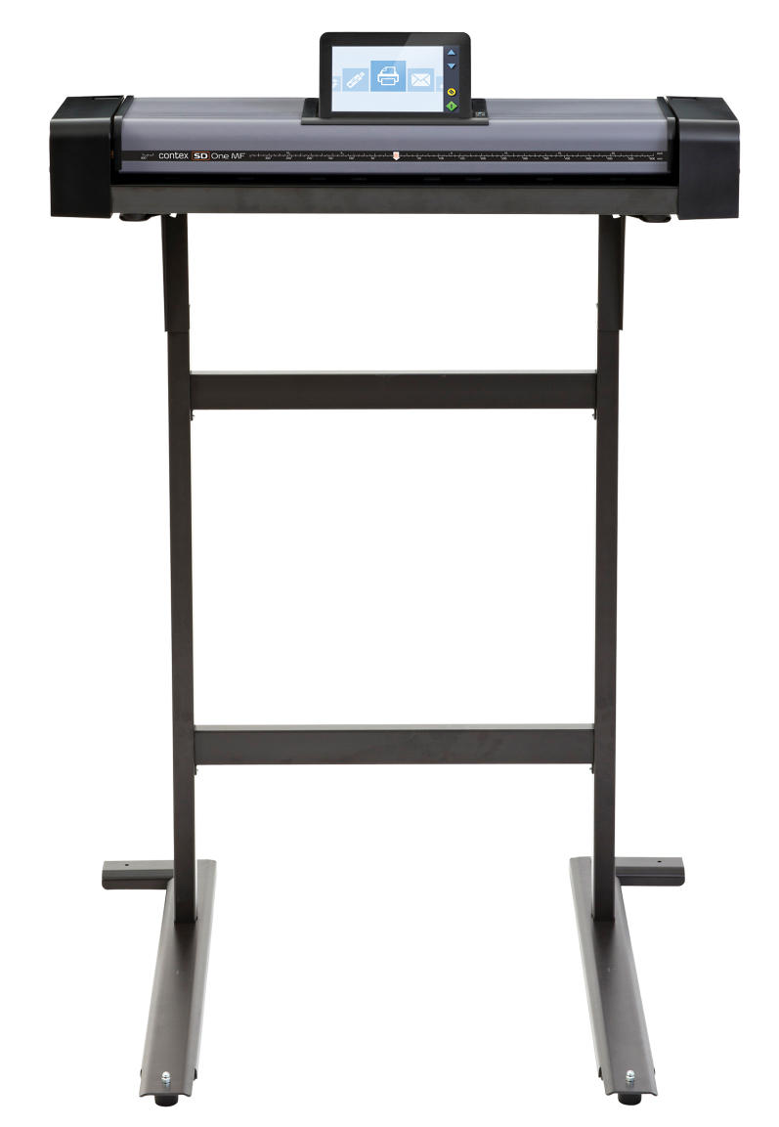
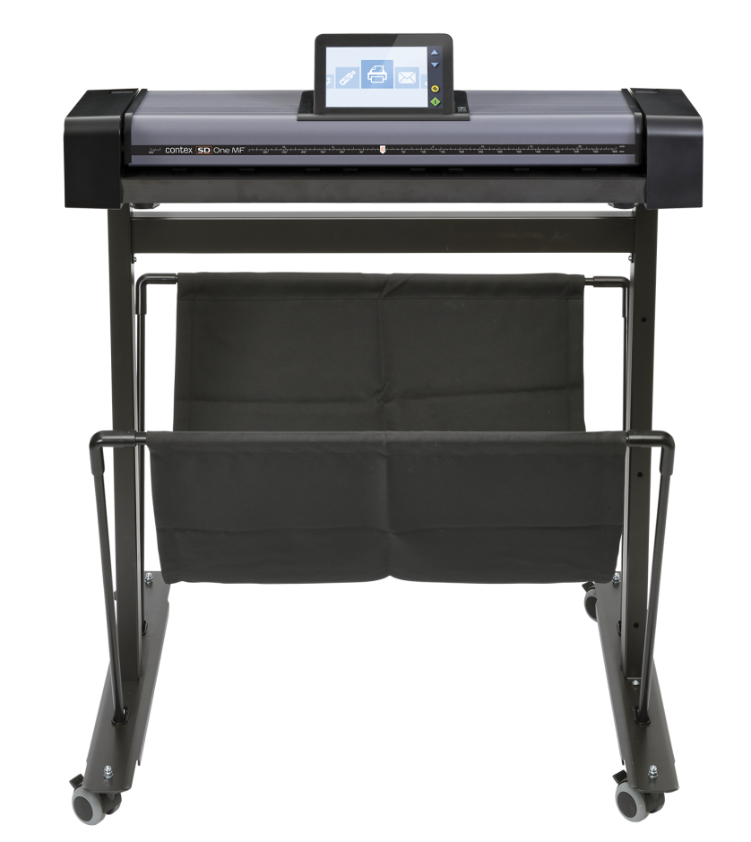
Two stand options
Same stand as SD One+

Slide 24
Integrated Cost Recovery
Universities, Facilities Management, Large firms.
Connect your preferred cost recovery solution.
User will be asked for a PIN before scanning and copying.
All scans and copies will be tracked.

Slide 25
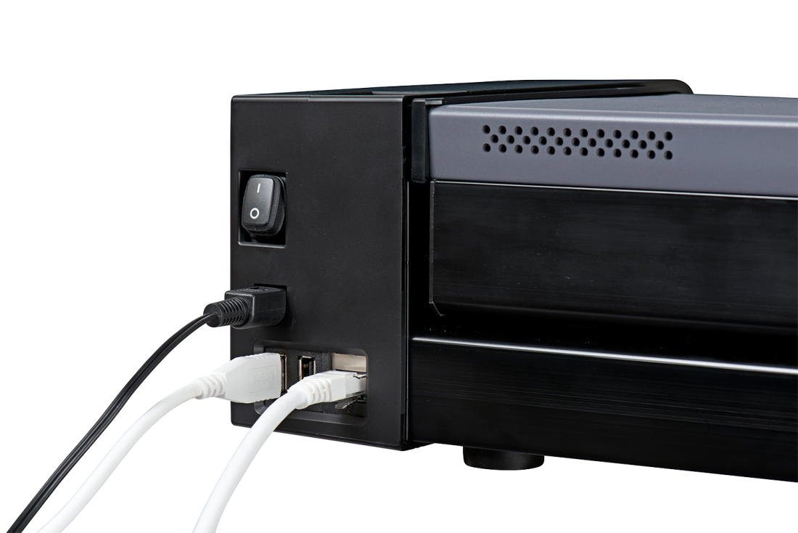
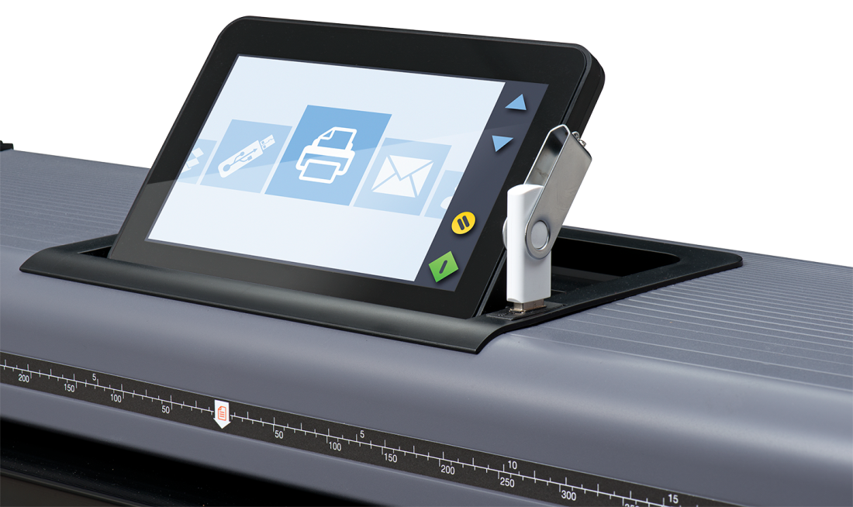
Connectivity
Scan to USB 3.0 right on the scanner.
Connect to Network Printers and LINK using WiFi or Gb Ethernet
USB connections for Cost Recovery.

Slide 26
Key Specifications
Feature | Specification
Models | 3 models: 24” / 36” / 44”
Scan Technology | Contex CleanScan CIS with dual sided light
Scan width / document width | 24” model: 24 inch (610 mm) / 26.6 inch (675mm) 36” model: 36 inch (914 mm) / 40 inch (1014mm) 44” model: 44 inch (1118 mm) / 42.2 inch (1067mm)
Min scan length | 8 inch / 203 mm
Max scan length | 50 inch / 1270 mm
Paper path | Front entry, rear exit with return guides.
Accuracy | 0.1% +/- 1 pixel
Resolution | 150, 300 and 600 dpi only
Speed: Color and Grayscale | 150 dpi 3.8 ips 300 dpi 1.9 ips 600 dpi 1.0 ips
File formats | PDF, PDF/A, TIF and JPG

Slide 27
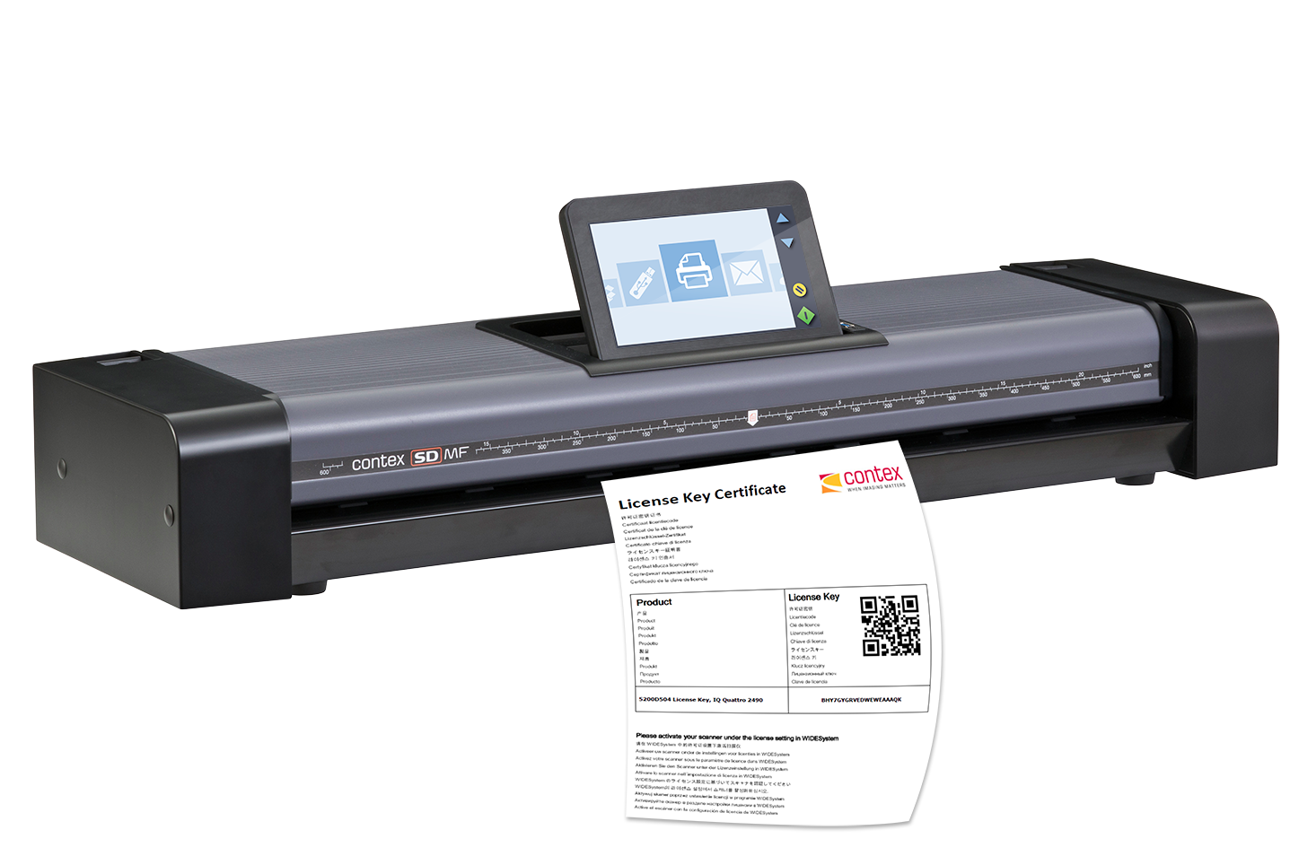
Activation

Slide 28
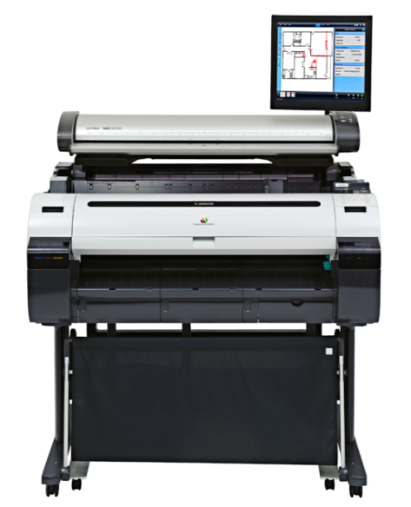
Turn any printer into a copier

Slide 29
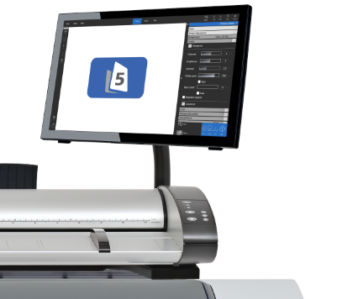
More power in every copy
IQ Quattro MFP Repro combines all the best in one, powerful MFP solution.
Market leading IQ Quattro scanner
Full featured award winning Nextimage REPRO software
All scanning and copying features
Support unlimited printers including all windows printers.
Now available in 36” – IQ Quattro 36

Slide 30
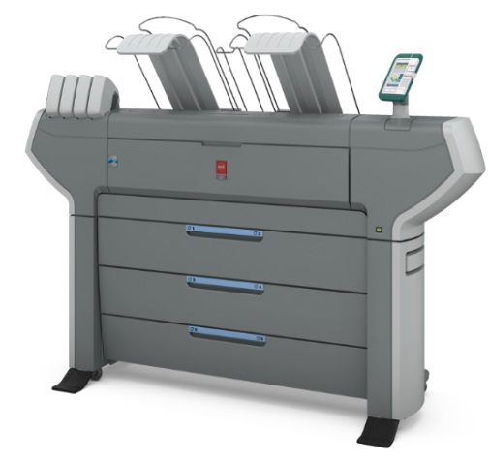
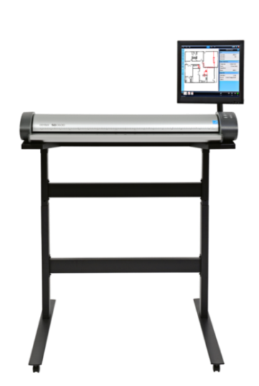
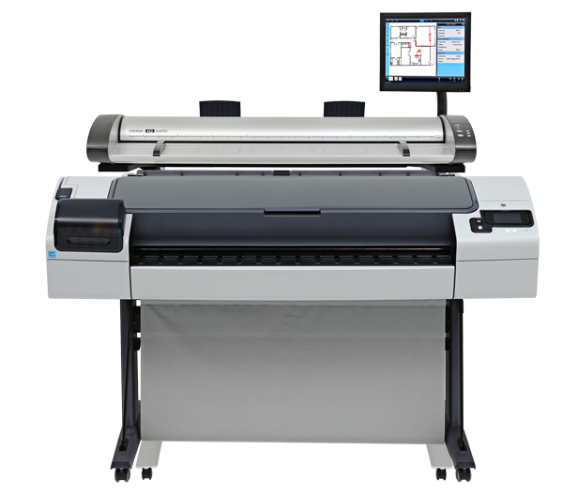
Fit all leading printer brands
HP DesignJet series
Canon IPF and other series
EPSON Stylus Pro and SC-T series (some as side-by-side)
Océ Colorwave, Plotwave, others (side-by-side)
Kyocera, Mutoh, Ricoh, Xerox, Etc.
Full printer list at www.contex.com/nextimage

Slide 31
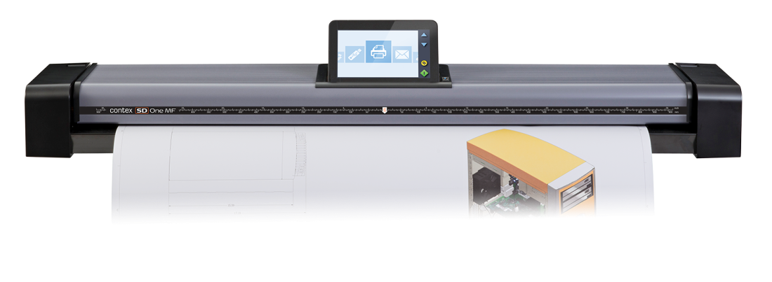
MFP Solutions
SD One MF 24 | SD One MF 36 | SD One MF 44 | IQ Quattro 36 MFP Repro | IQ Quattro 44 MFP Repro
24” scanner | 36” scanner | 44” scanner | 36” scanner | 44” scanner
Up to 3.8 ips | Up to 3.8 ips | Up to 3.8 ips | 2 ips color scanner | 2 ips color scanner
600 dpi | 600 dpi | 600 dpi | 1200 dpi | 1200 dpi
Built in controller | Built in controller | Built in controller | Nextimage REPRO | Nextimage REPRO
High or low stand options | High or low stand options | High or low stand options | High or low stand options | High or low stand options

Slide 32
Feedback & Questions?

